Slide 1

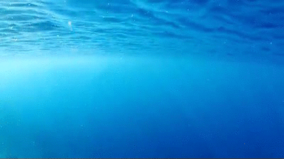
A Fishy Analysis
By Mike Lawrence

Slide 2
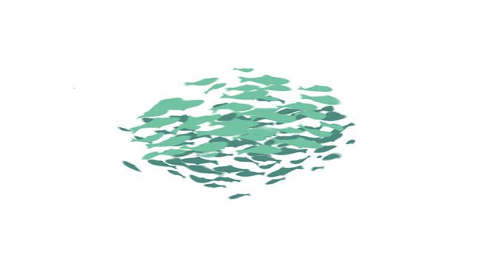
Catch of the Day (🐠 Agenda 🐠)
We’re going to:
Learn about sportfishing
Use webscraping to collect data from the internet
Dive into some NLP (natural language processing) to understand text data
Notes:
https://www.sandiegomagazine.com/features/a-deep-dive-into-the-san-diego-fishing-industry/article_2959b344-d518-5cf0-b2d7-a952673fc231.html
Article that highlights rebound of tuna populations and sustainable fishing in san diego

Slide 3
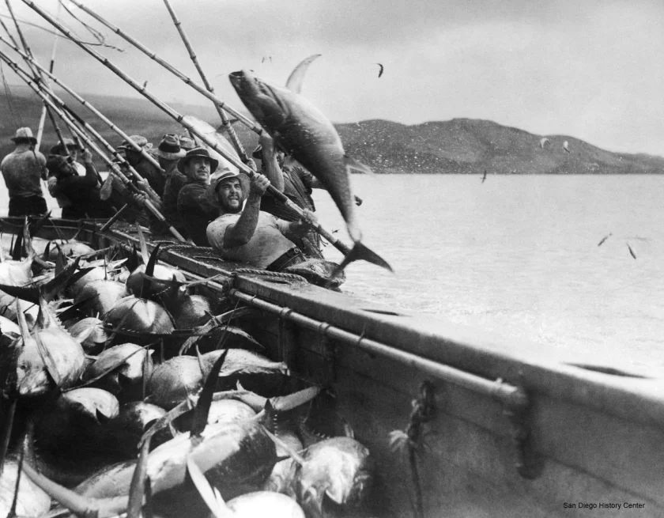
Deep-Sea Fishing in San Diego over the past ~100 years
*all excerpts from SD Union Tribune
Fun facts:
Tuna used to be San Diego’s third-largest industry (first cannery opened in 1909)
San Diego touted as “tuna capital of the Pacific,” canning 95% of packed tuna by 1940
Lawmakers protect dolphins in 1972, prompting local ships to shift operations to western Pacific and South America.
Notes:
Photo: https://www.sandiegouniontribune.com/business/growth-development/sdut-tuna-san-diego-fish-story-2012jun16-htmlstory.html
1950s tuna was huge here
But 50 years ago, tuna was San Diego’s third-largest industry, behind the Navy and aerospace. It employed some 40,000 San Diegans in catching, canning and marketing the product. Two of the three big tuna canning companies were based here, and the waterfront was home to four canneries and scores of fishing boats

Slide 4
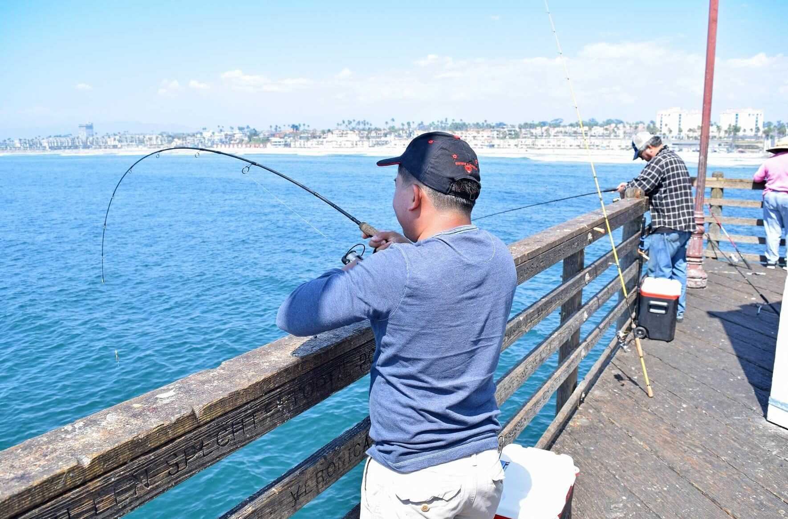
Today’s ecosystem
Heavy regulation on size of fish and quantity you can keep
Heavy recreational use, less commercial
Lakes and rivers are overfished - ocean is much easier!

Slide 5
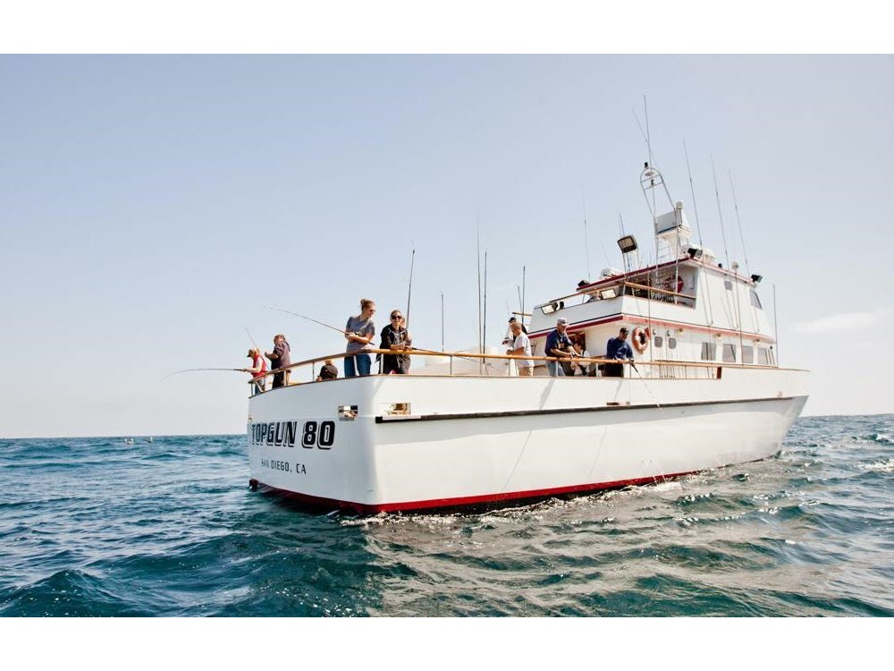
Today’s ecosystem

Slide 6
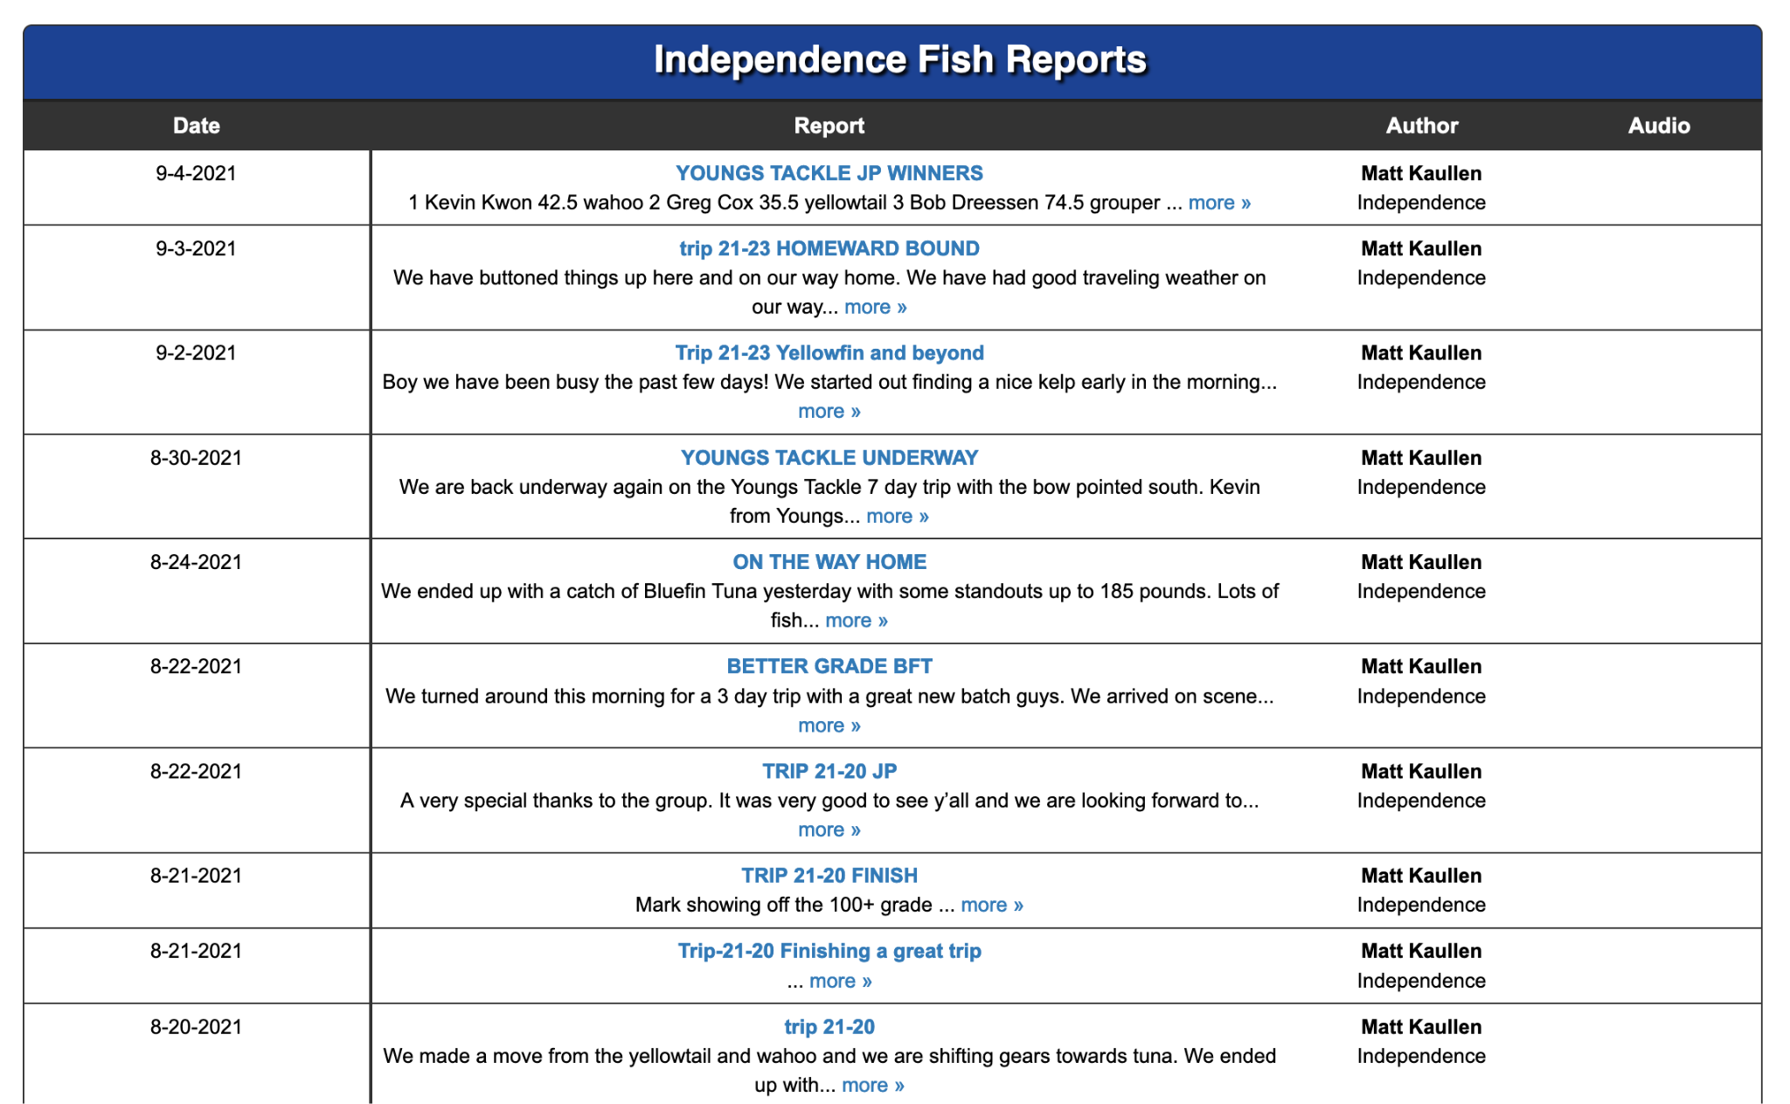
Today’s ecosystem

Slide 7
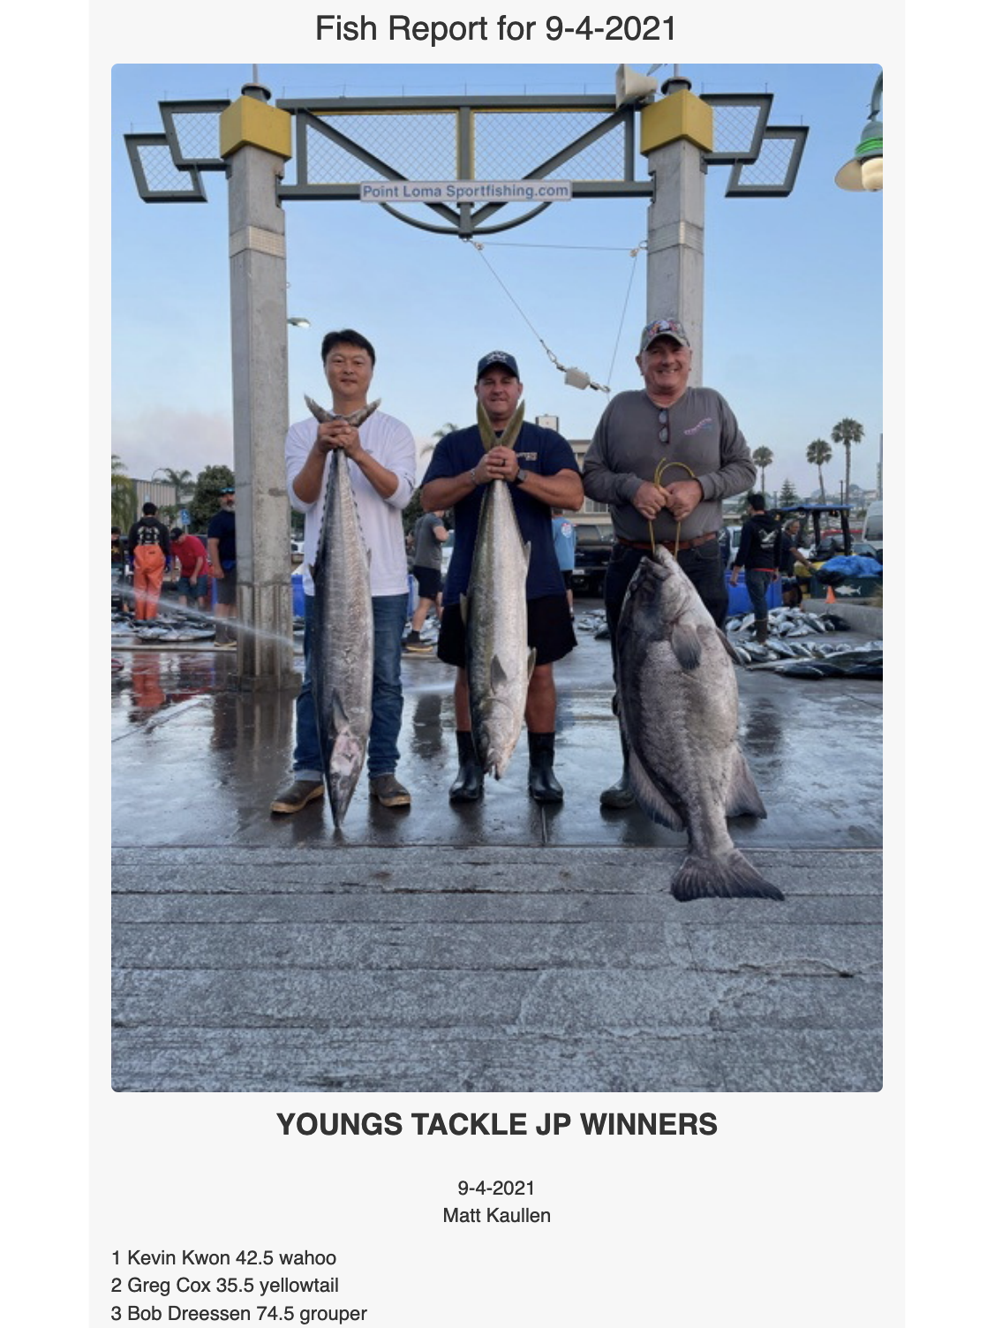
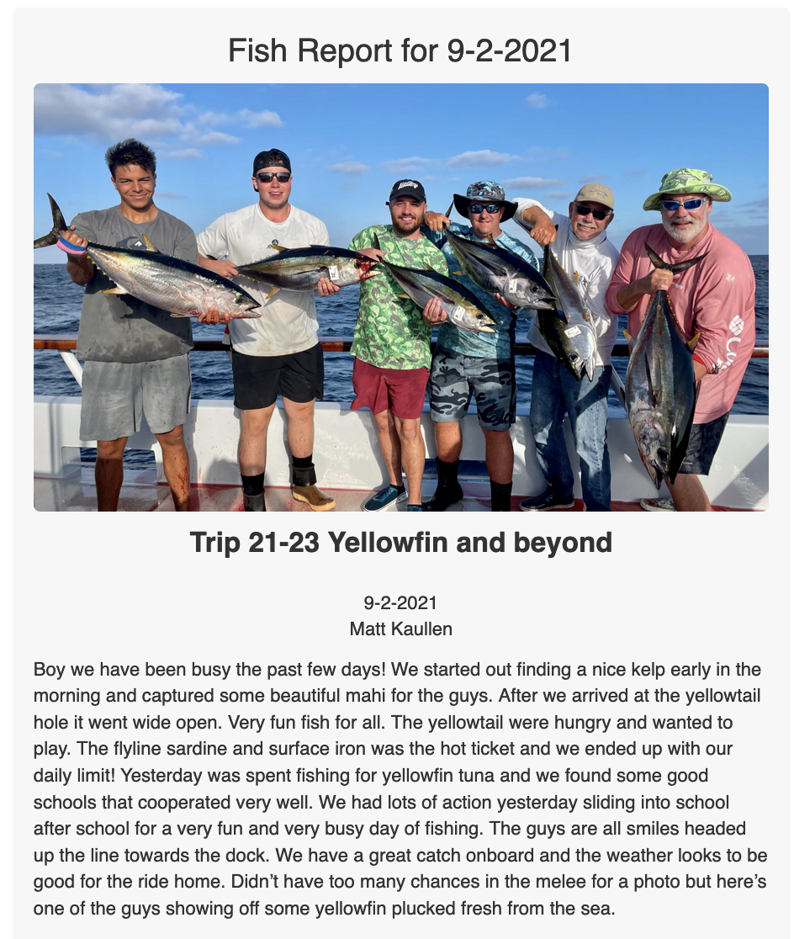
Today’s ecosystem

Slide 8
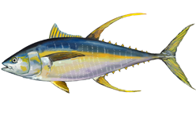
Some questions to explore
What is the culture of the boats like? What do they post about?
What fish do they catch, and when are they caught?
Does weather matter? We’ll be skipping this due to data constraints

Slide 9
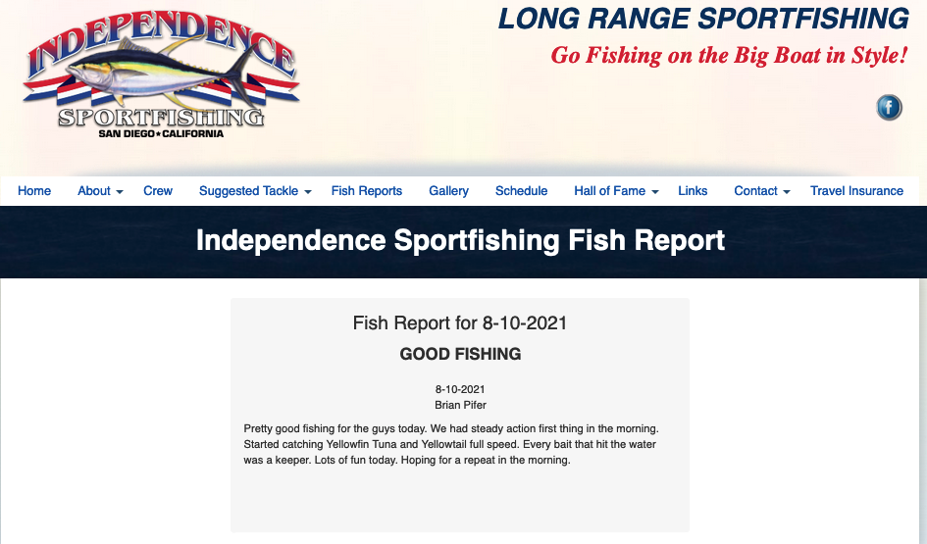
What we’re analyzing
Date
Captain’s notes

Slide 10
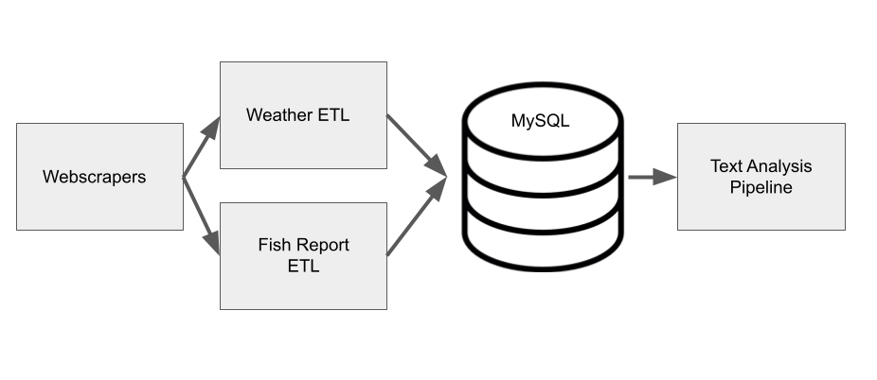
Collecting data
We’ll only skim over this

Slide 11
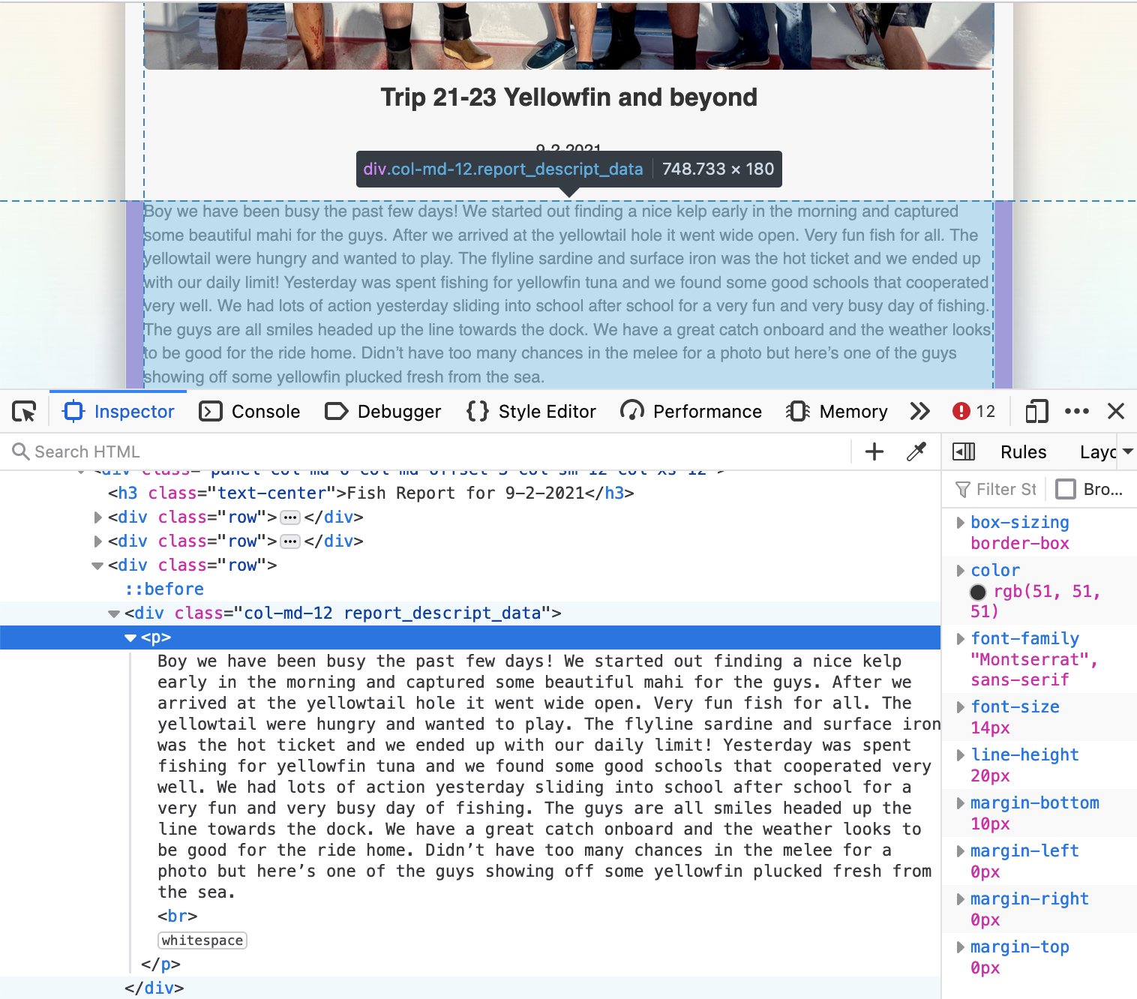
Webscraping

Slide 12
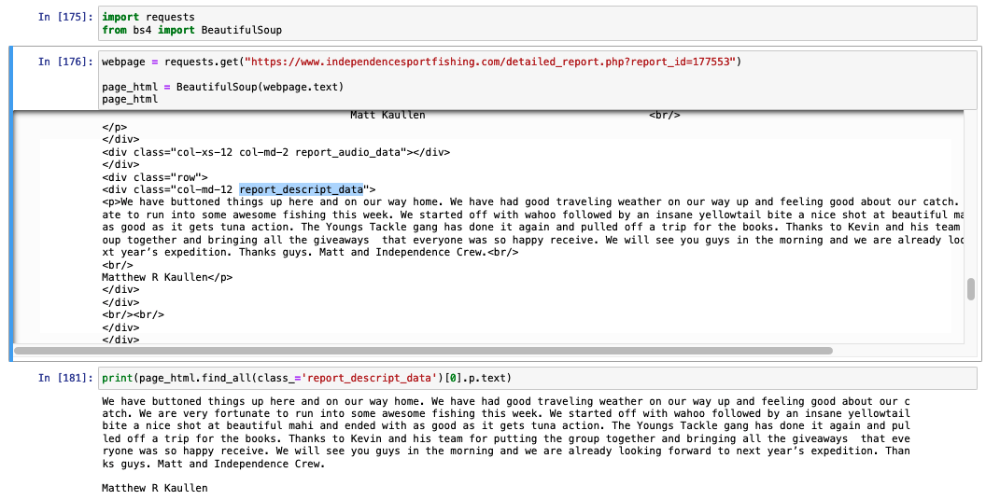
Webscraping

Slide 13
Webscraping
Filter webpage by HTML elements

Slide 14
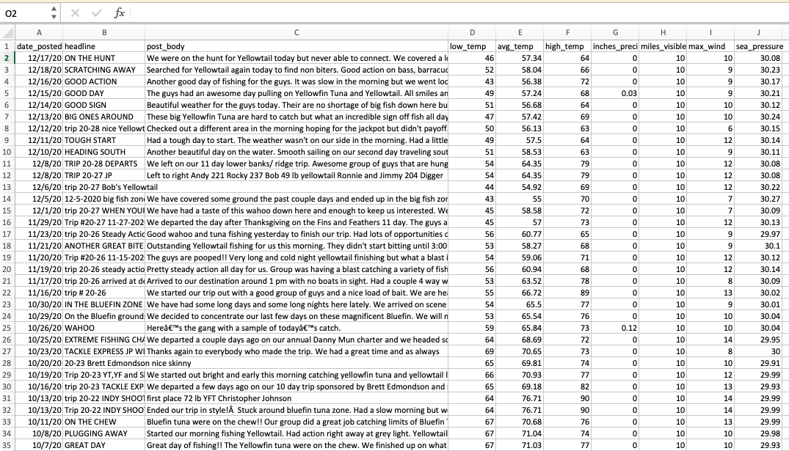
The data (~3k posts, from 2005 to 2020)

Slide 15
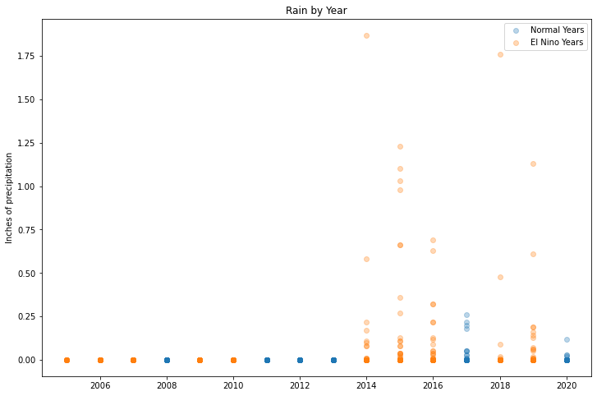
Weather database online has missing data - not useful :(

Slide 16
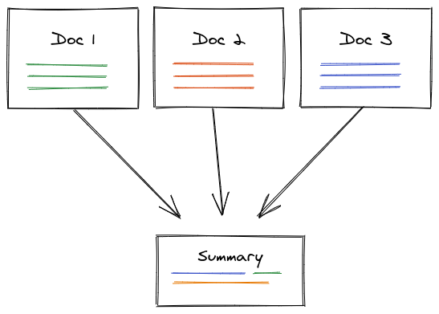
What are they talking about in these posts?
Text summarization methods → understand boat culture

Slide 17
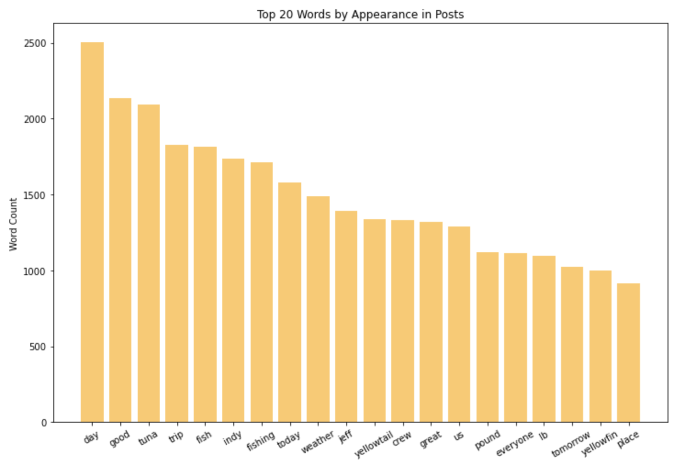

Slide 18
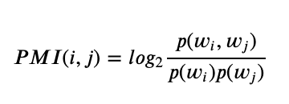


Beyond single words - Phrases via PMI
Words that occur together frequently are likely to be phrases *if* the words aren’t generic.
“Wells Fargo”
“and the”
High PMI → phrase likely
Low PMI → phrase unlikely

Slide 19
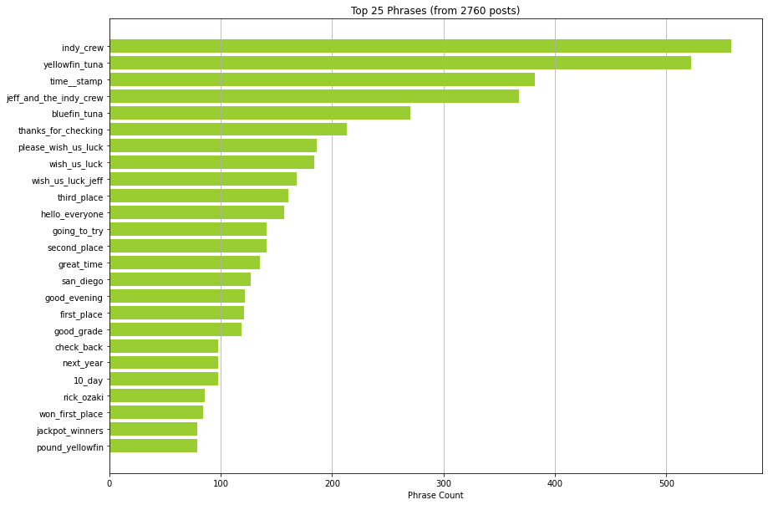
Top phrases

Slide 20
Top phrases
Tuna!
Rankings!

Slide 21
Today’s ecosystem
Attendees are ranked, and the popular phrases show this

Slide 22
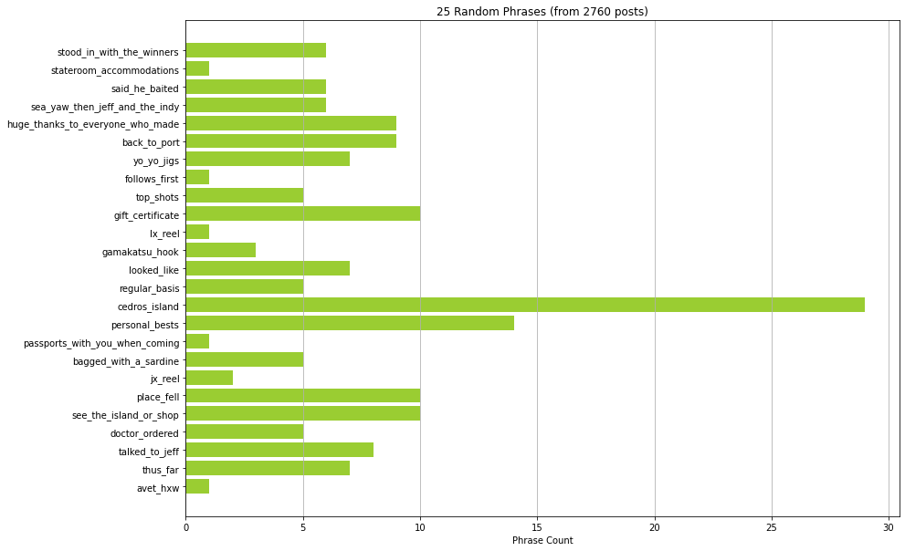
A few random phrases
Cedros Island?
Passports?

Slide 23
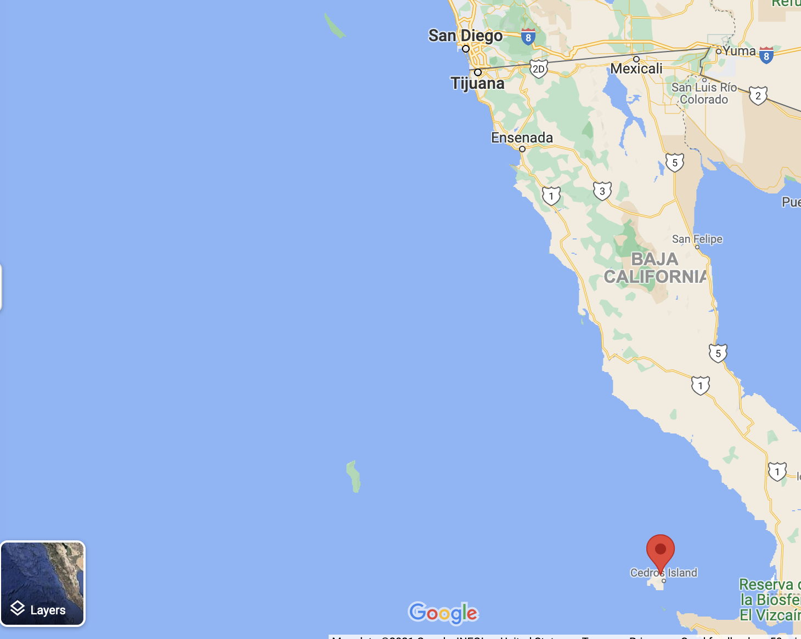
Where is Cedros Island?
It seems some of San Diego’s best fishing isn’t in the US

Slide 24
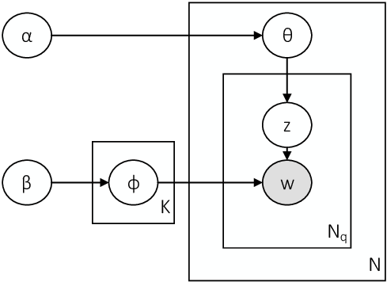
Summarize conversations with topic models
Clean up data - these don’t work well with short, messy tests
Group every word into a conversation (topic) based on how it’s used
Visualize these grouped conversations
Probabilistic, generative plate diagram for LDA

Slide 25
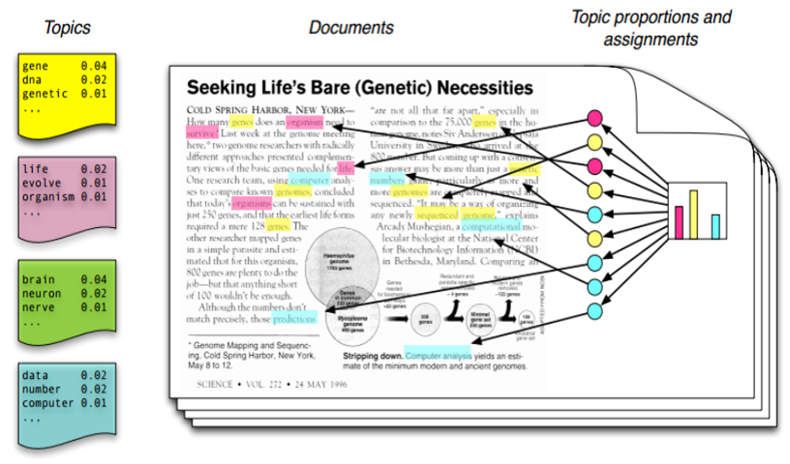
The LDA results

Slide 26
Language and Culture of Boats
We wanted to learn about the boat’s culture and way of operating via text mining
Some cool facts we found:
The boats will go deep into Mexican waters to fish
Yellowfin and Bluefin tuna are extremely popular
There is a jackpot system, where attendees are ranked by their fish size
The posts are used as a channel to broadcast deals

Slide 27
What are they catching, and when?
Need to know:
Timestamps on posts to detect seasonality
Names of fish in order to extract their mentions

Slide 28
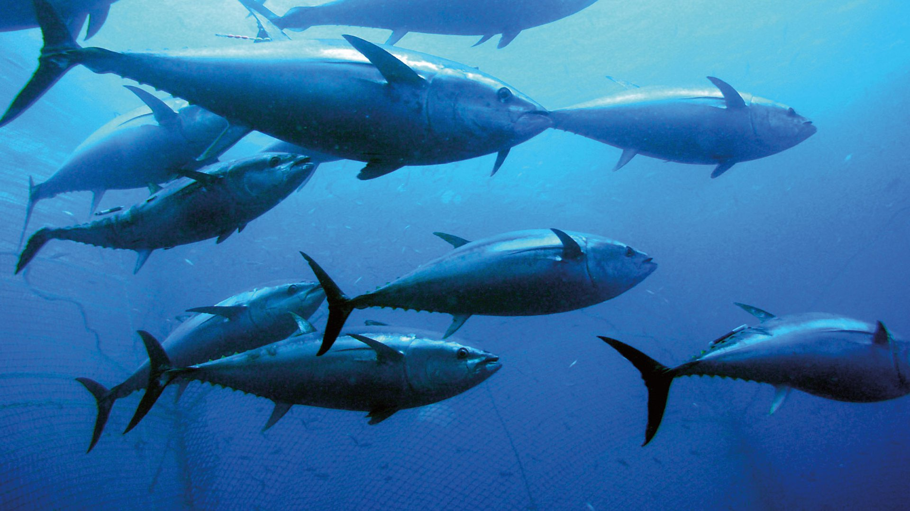
What are they catching, and when?

Slide 29
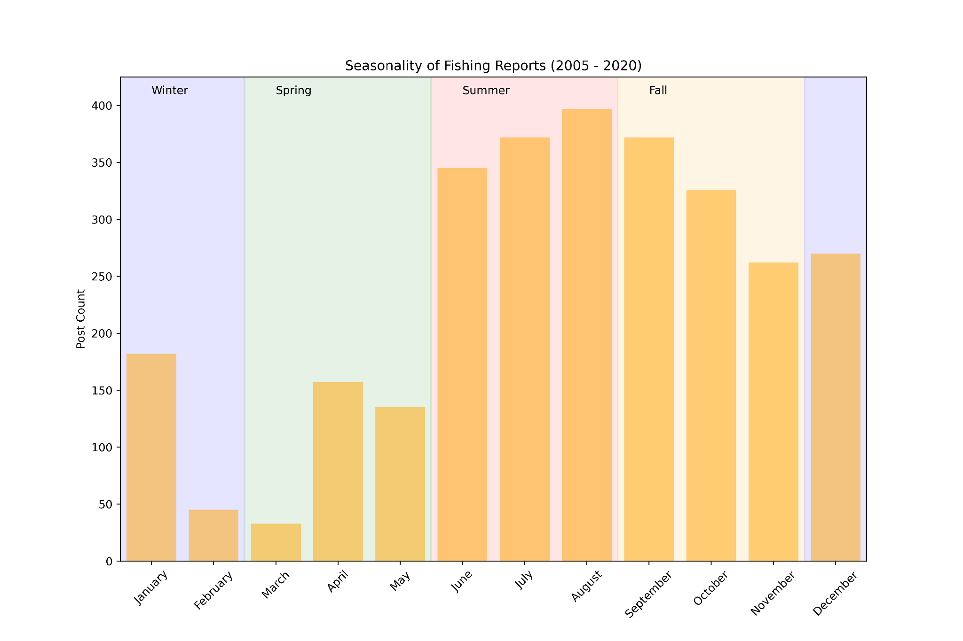
We have timestamps!

Slide 30
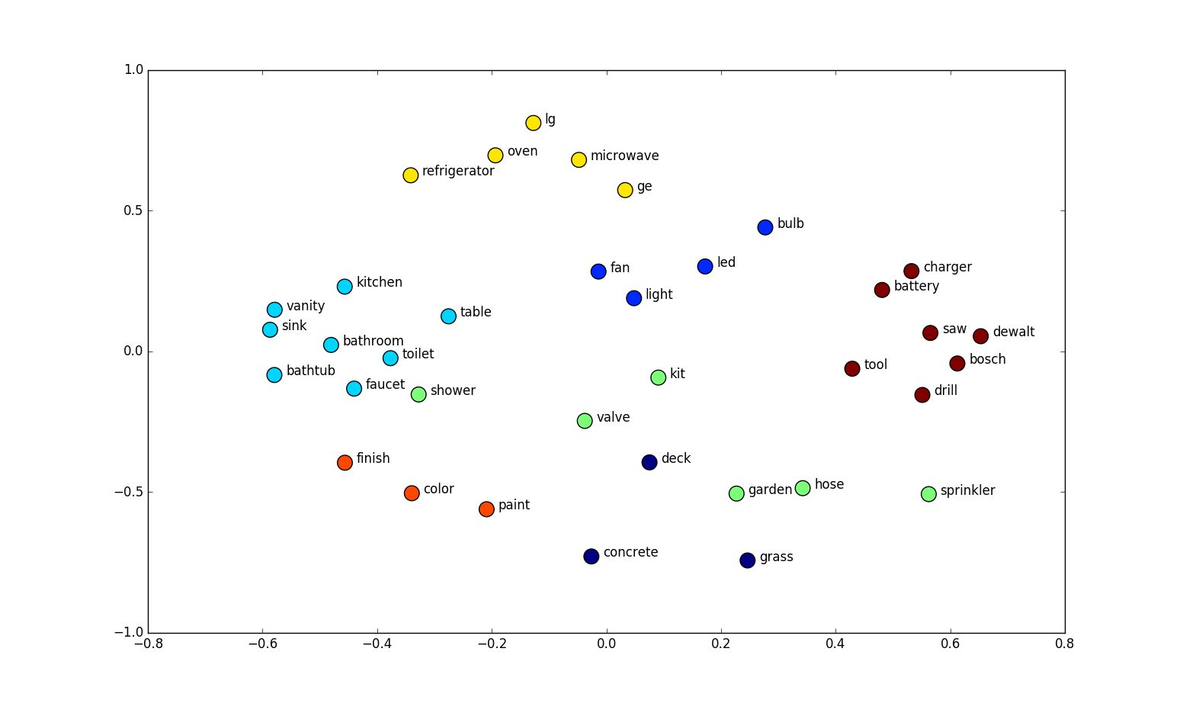
Which fish do they catch? Try word embeddings

Slide 31
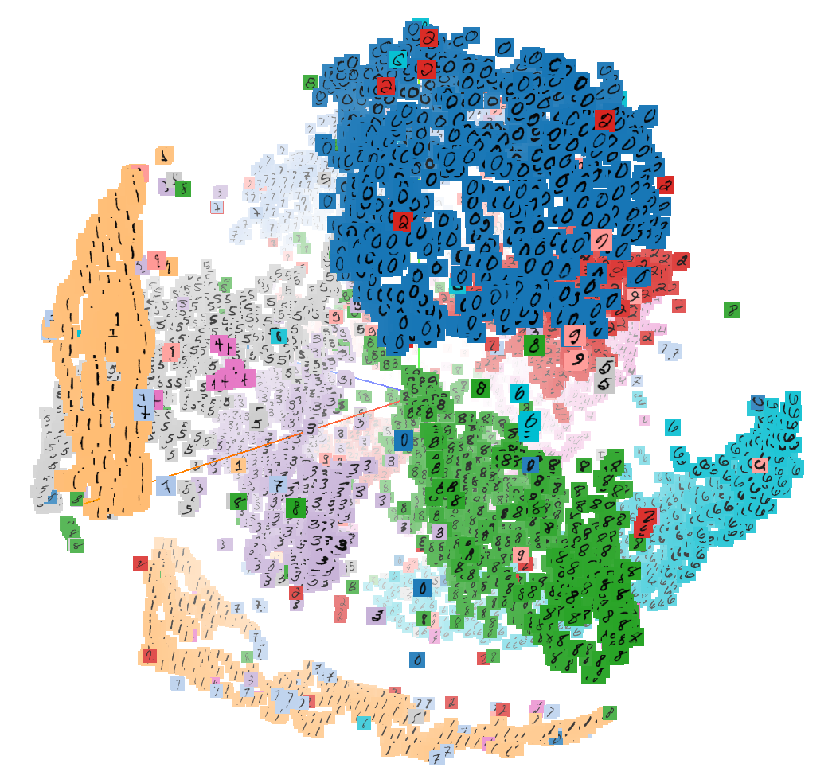
Embeddings provide a way to describe *similarity*
Hand-written digits cluster in this embedding space

Slide 32
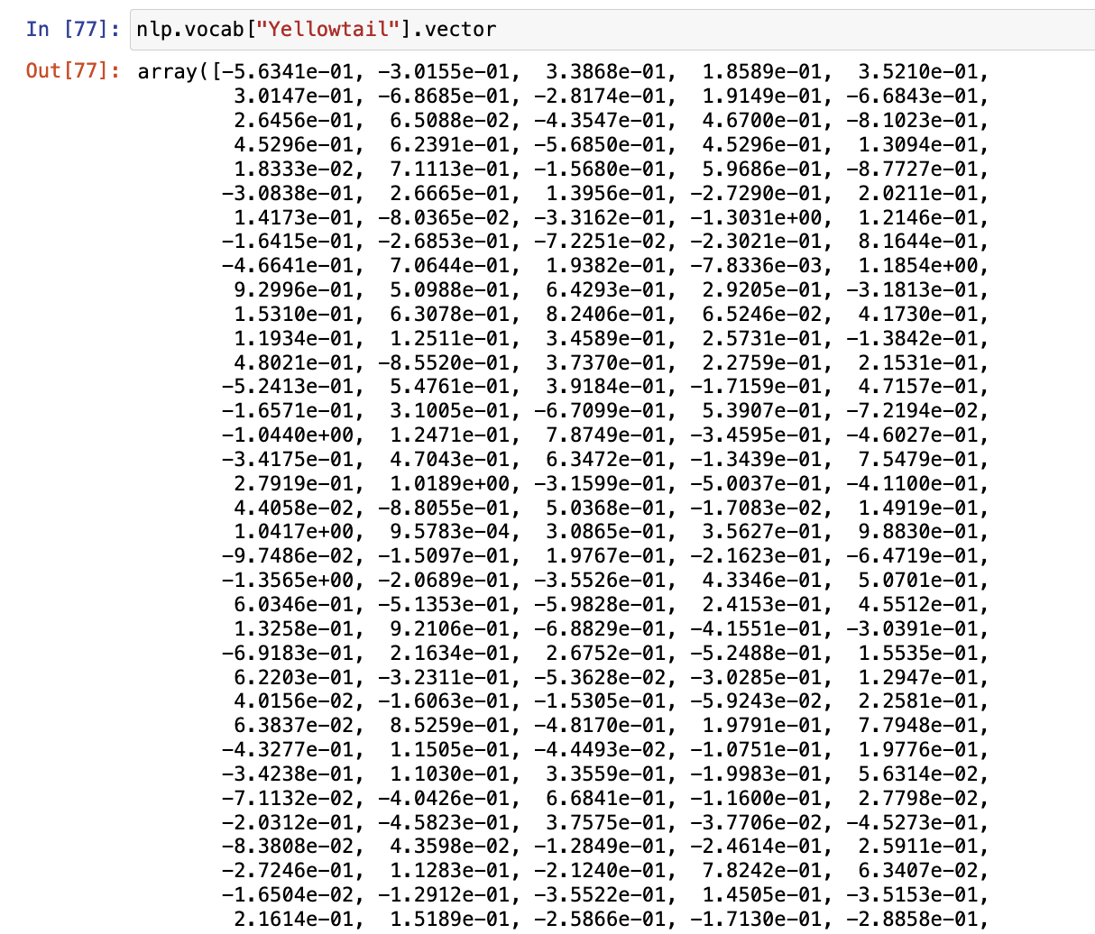
SpaCy gives 300-dimensional word embeddings

Slide 33
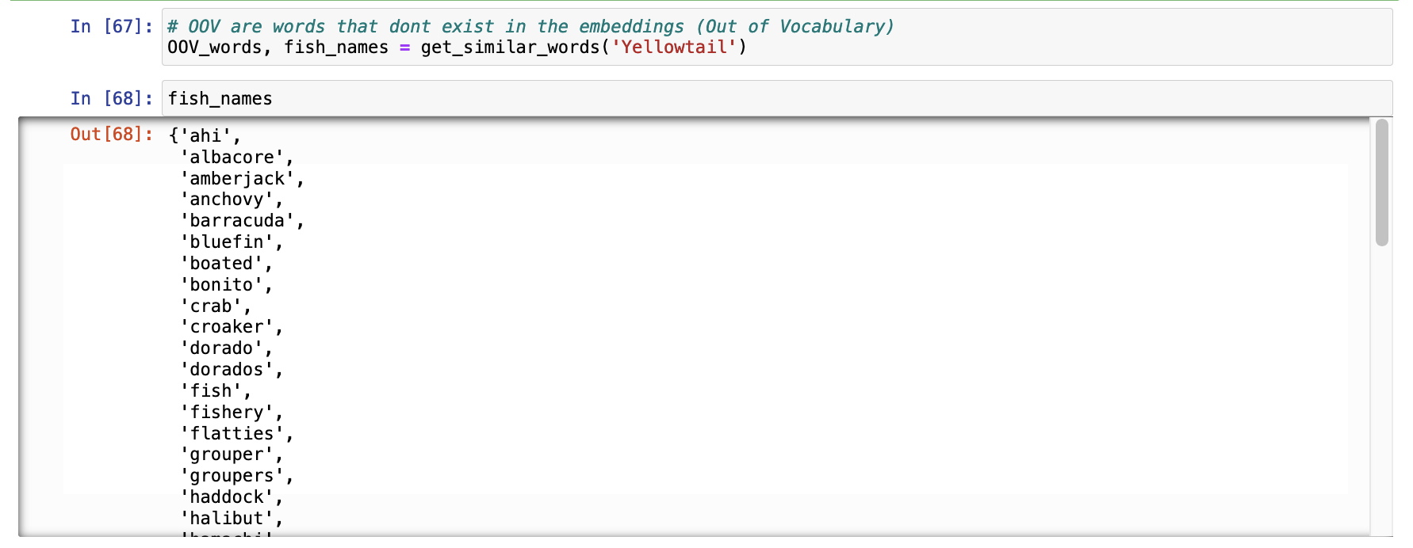
Use a fish name we know to find others

Slide 34
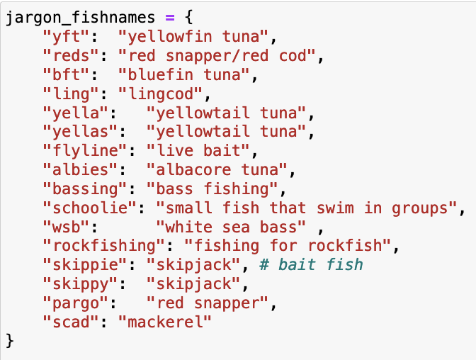
Not all words have an embedding in this library
OOV words are a way to find jargon!

Slide 35
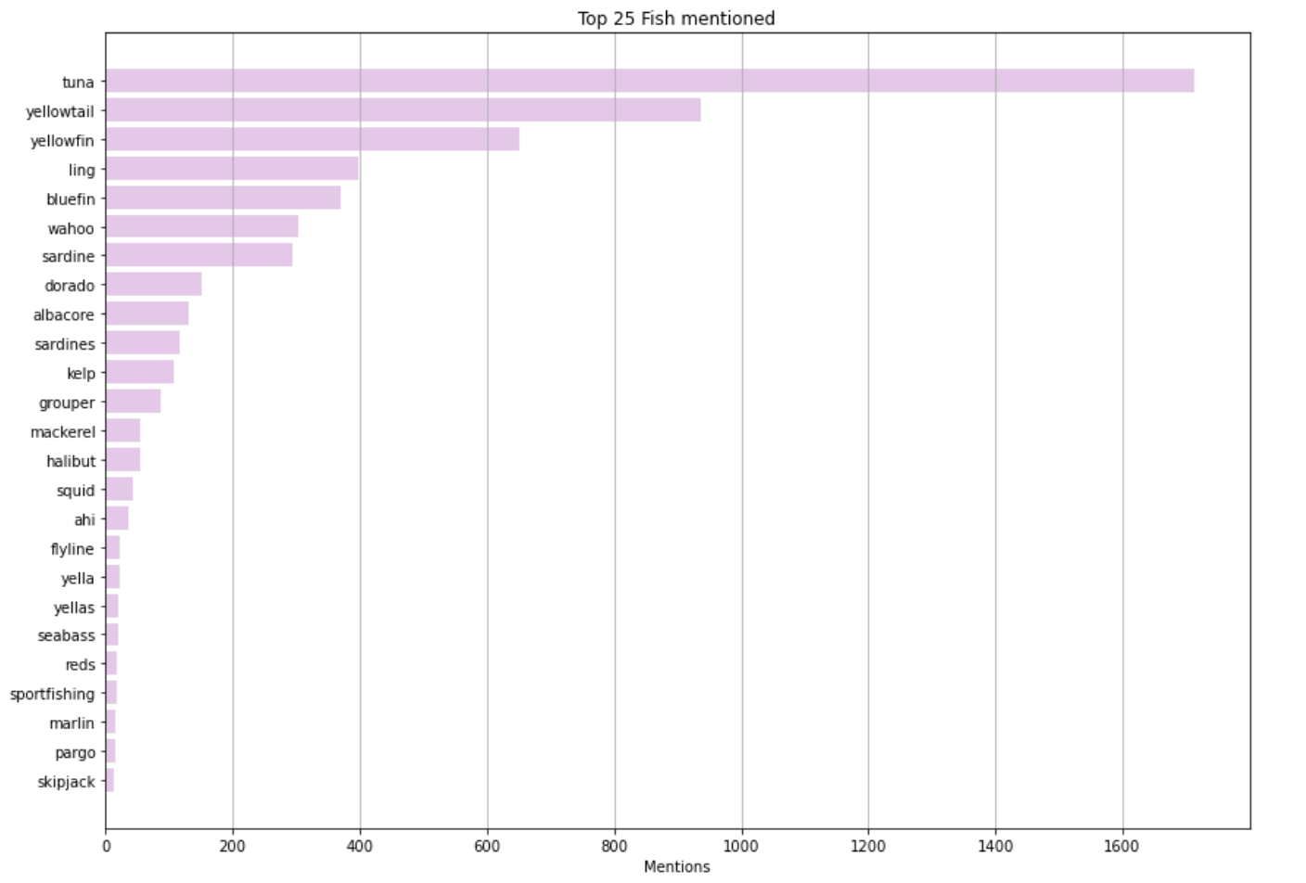
Total Fish mentions

Slide 36
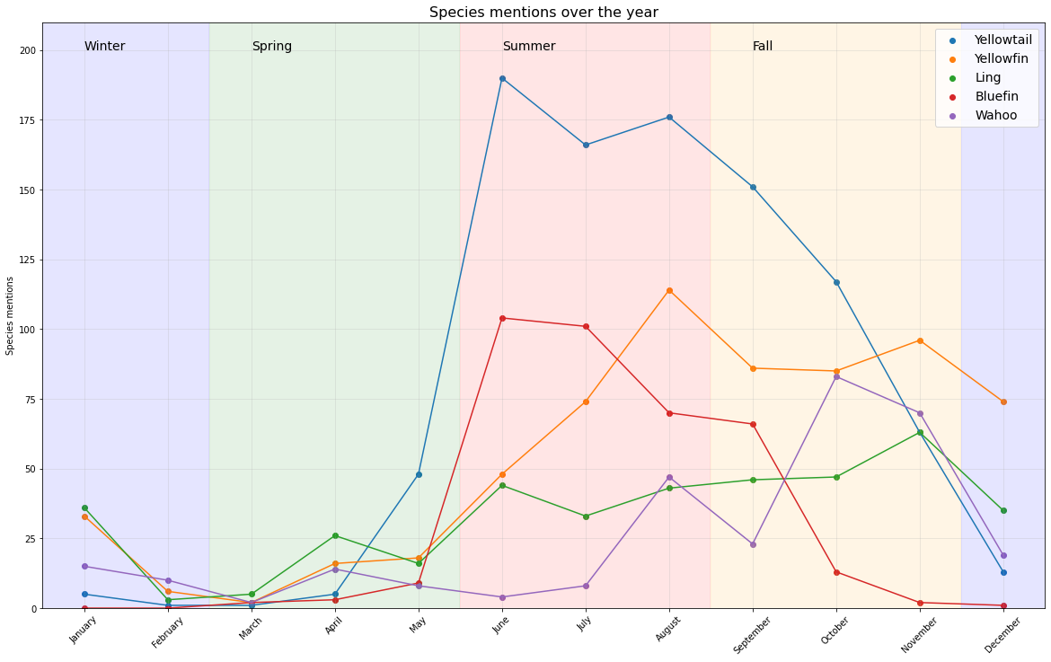

Slide 37
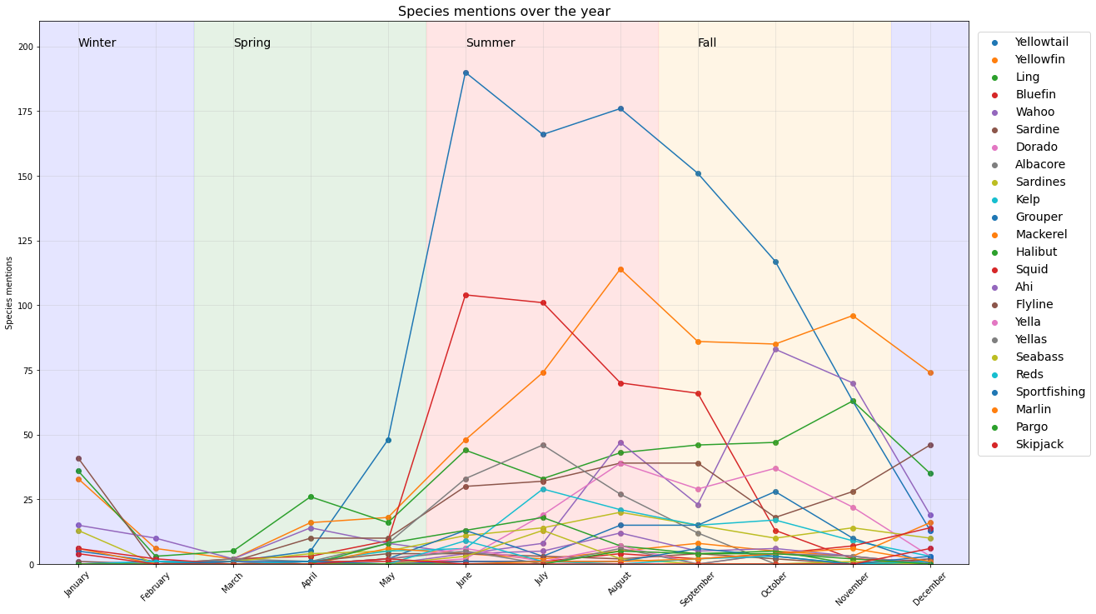

Slide 38
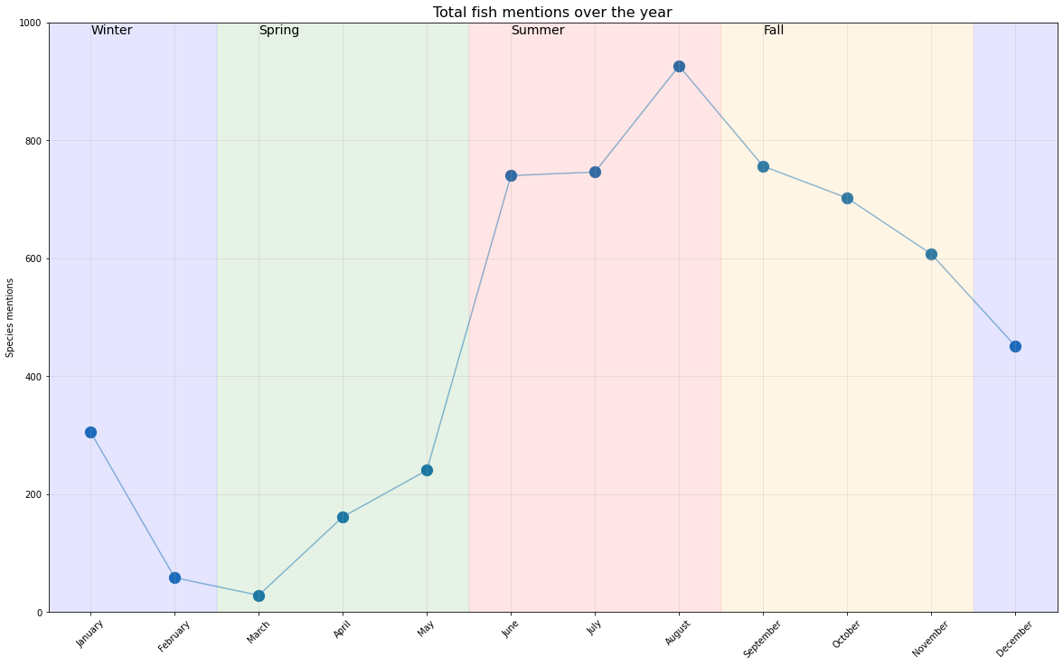

Slide 39
Future work
Extract fish size and quantity
Automated extraction of quantities is hard to get right with natural language
Detect anomalous days
Boats hit limit 45 times in the past 15 years. What conditions led to this?

Slide 40
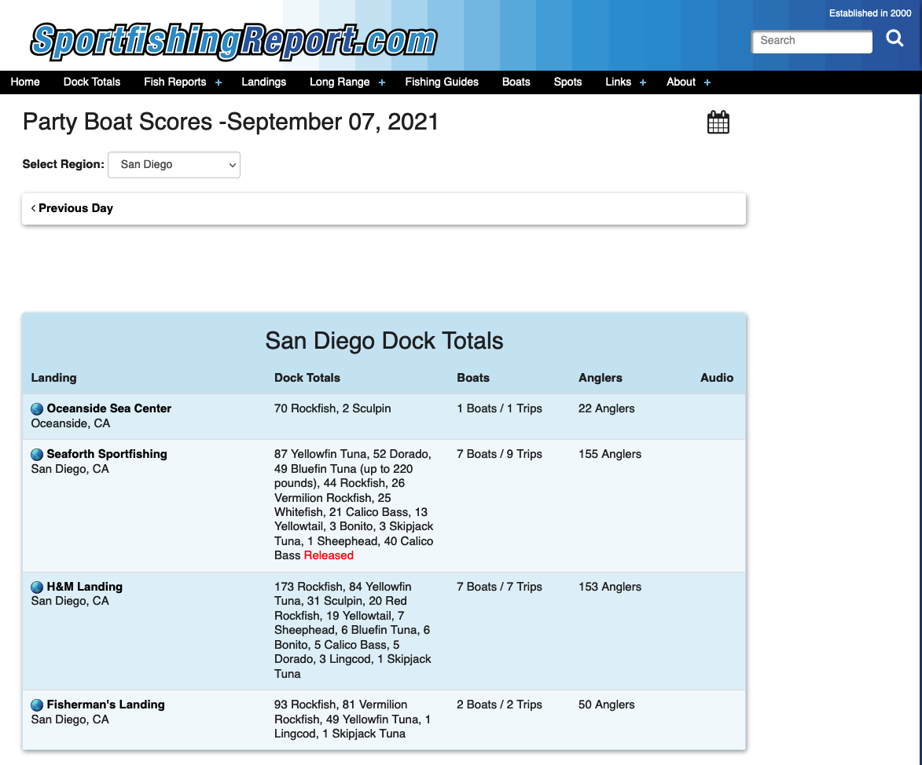

...Some of the data already exists!
(Me when I realized I could have scraped the data directly)

Slide 41
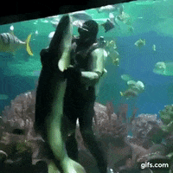
Questions?

Slide 42
Sources
gallery
https://www.independencesportfishing.com/gallery.php
Main site
https://www.independencesportfishing.com/index.php
Good article
https://www.sandiegomagazine.com/features/a-deep-dive-into-the-san-diego-fishing-industry/article_2959b344-d518-5cf0-b2d7-a952673fc231.html

Slide 43
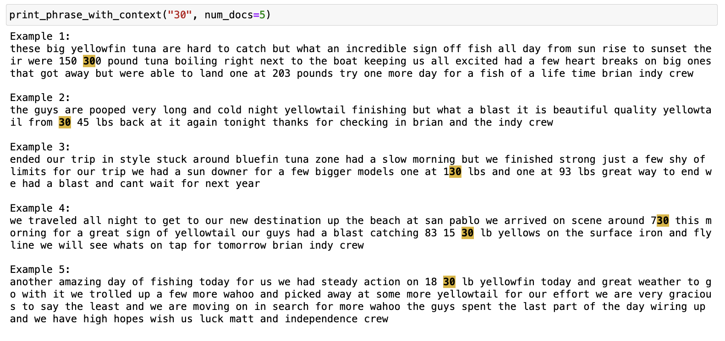
The quantity problem

Slide 44
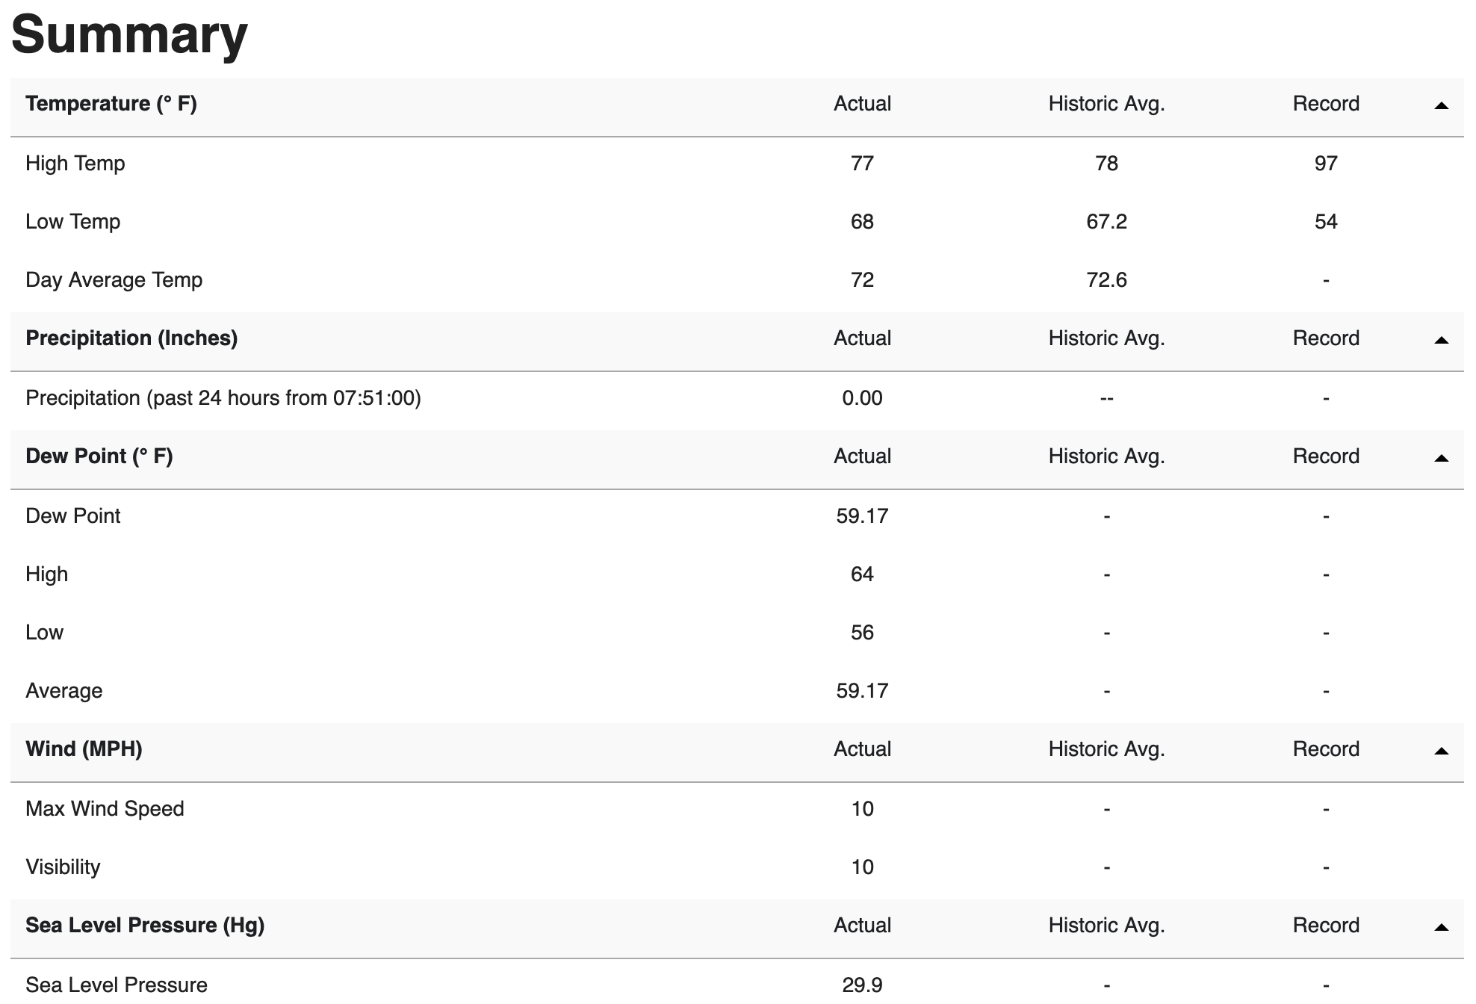

Slide 45
Weather url
https://www.wunderground.com/history/daily/us/ca/san-diego/KSAN

Slide 46
What can we learn?
Language used by fishermen. What do they care about? Is there jargon?
Seasonality of sportfishing - when is the best time? Does temperature matter?
Fish species - what’s in SD, and how are they discussed?

Slide 47
Catch of the Day (🐠 Agenda 🐠)
A brief history of fishing in San Diego
Goal
Programatically understand fishing patterns
Approach
Data collection
Cleaning
Main analysis
Future work
Notes:
https://www.sandiegomagazine.com/features/a-deep-dive-into-the-san-diego-fishing-industry/article_2959b344-d518-5cf0-b2d7-a952673fc231.html
Article that highlights rebound of tuna populations and sustainable fishing in san diego

Slide 48
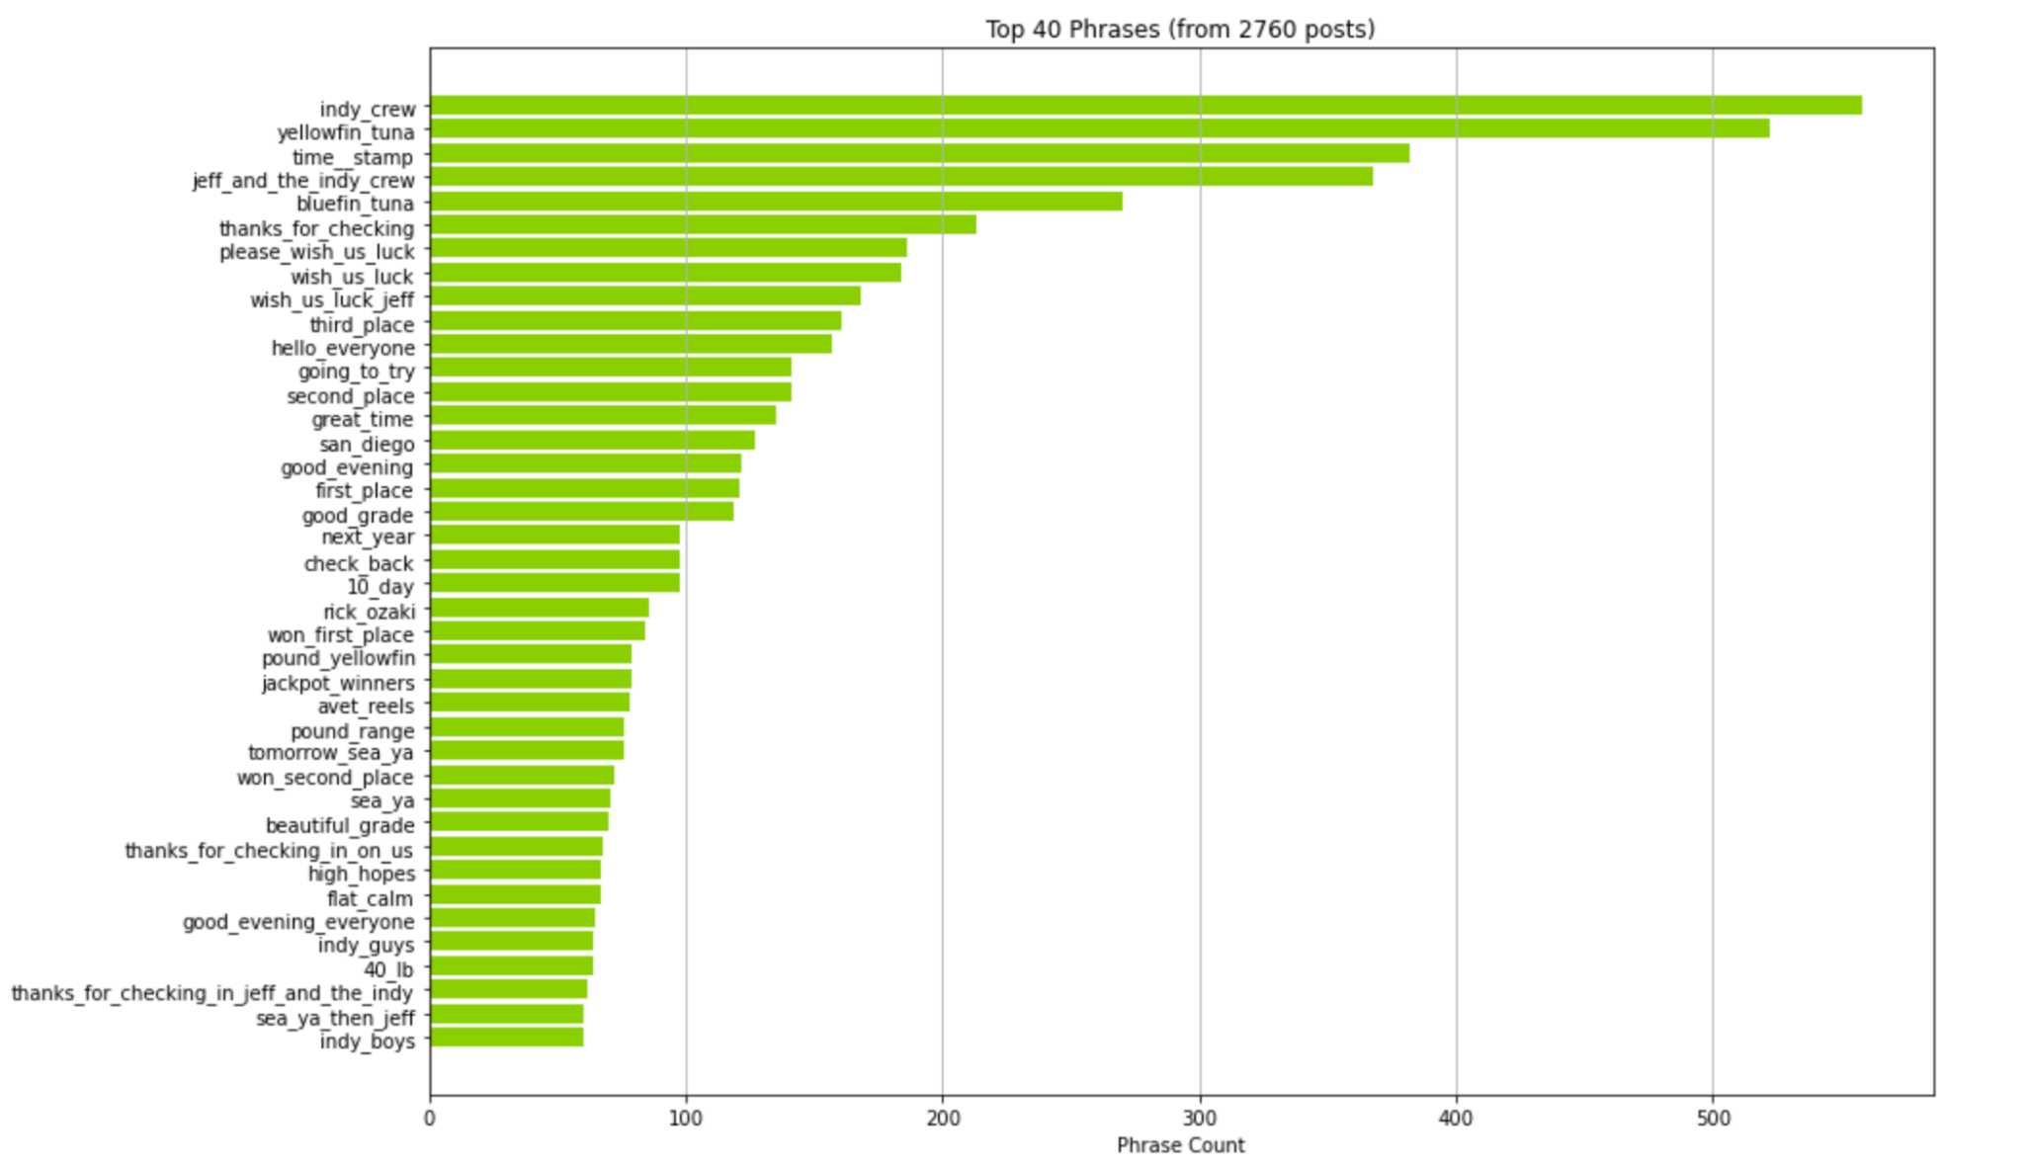
Top phrases

Slide 49
Which fish do they catch? Try word embeddings
Hand-written digits cluster in this embedding space

Slide 50
Which fish do they catch? Try word embeddings

Slide 51
Which fish do they catch? Try word embeddings
Hand-written digits cluster in this embedding space

Slide 52
Embeddings provide a way to describe *similarity*

Slide 53
Collecting data

Slide 54
What is “Cedros Island”?
Example 1:
captian mark pisano called in from the independence this afternoon with an update from cedros island we are in the middle of a 6 day trip we had excellent fishing for two days on nice grade bluefin tuna the majority of the bluefin were in the 50 to 70 pound class we are currently fishing nice big yellowtail at isla cedros and we will be visiting the offshore grounds for tuna on the way back home it has been a great trip we will update you in a couple days
Example 2:
hello again we had good fishing and weather today the main target species was yellowfin tuna and the fishing was slower for the tuna however we did pick up a fair share to go along with lots of yellowtail and dorado that we released currently cedros island is the next stop to enjoy the scenery and weather along with a little catch and release calico bass have a good day the indy crew
Example 3:
wide open yellowtail chad woods with live update from cedros island aboard the independence they already got 150 yellowtail from this morning theyre biting surface iron yo yoing jigs and live sardines theyll probably get limits shortly more updates to come call judy at independence sportfishing at 619 226 6006 to book your next trip dont miss out

